Slide 1
Guide to understanding
Mistake Detection System
by Prabhsimran Singh

Slide 2
Topics Covered
What is Mistake Detection System?
How does it work?
Which Mistakes it covers?
A Poster explaining the system
How is the system tested?
Understanding the test cases.
Writing a sample test.

Slide 3
What is Mistake Detection System?
The Mistake Detection System automates the process of detecting modelling mistakes in domain models by comparing student solutions with a correct solution.
The automated feedback provided by the mistake detection system allows a larger number of students to receive valuable feedback compared to a manual approach, which is constrained by the availability of teaching staff.

Slide 4
How does it work?
Compare the class diagrams
Establish Mappings
Keep tracks of mapped and unmapped elements
Check for mistakes in elements
Returns mappings and mistake list

Slide 5

Which Mistakes it covers?
It will cover 53 different types of Mistakes.
At present code for 12 mistakes have been written and tested.
(be aware this number will increase as I work more ☺)

Slide 6


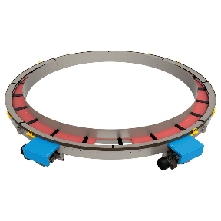

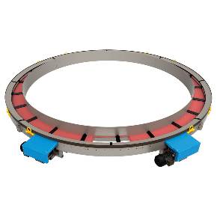

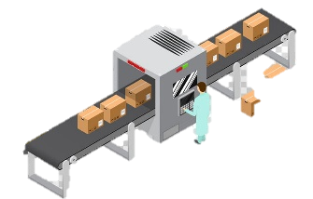


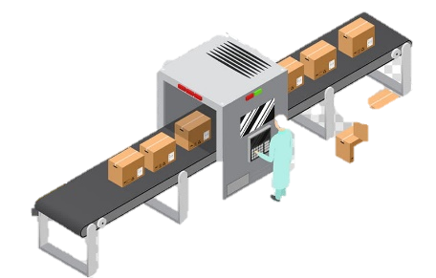







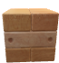
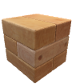
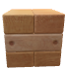



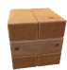

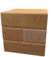

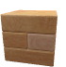

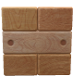
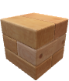





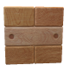

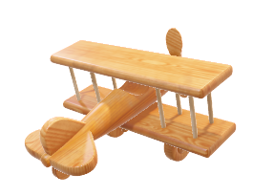
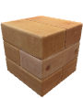
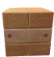


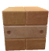


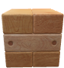
Domain Modelling Mistake Detection System
Prabhsimran Singh, Gunter Mussbacher, McGill University, Montreal, Canada
Introduction
Current and upcoming state of the research project
Knowledge about the system's problem domain is crucial for successful system development. Hence, domain modelling with class diagrams is an important Requirement Engineering activity, which is routinely taught in undergraduate and graduate programs. The proposed system automates the process of detecting modelling mistakes in domain models by comparing student solutions with a correct solution.
1. Compare class diagrams element by element
Student Solution
Instructor Solution
Problem Statement
Un-Mapped Elements
Mistake Detection
Submit Correct
Solution
Successful
Under research
Can you check our solution professor
Sure
Model Element
Mapped instructor and student solution element
4. Detect mistakes in un-mapped elements
Submit Solution
Instructor
Mapped + Un-Mapped Elements
Submit Solution
Under research
Successful
Get Feedback
One by one
Get Feedback Simultaneously
Under research
Successful
Student
Instructor
Student
2. Detect mistakes for mapped elements
3. Detect global mistakes beyond element pairs
Traditional Approach
Proposed Approach
Algorithm Overview
Benefits from
participation
Main Goals and Objectives
Relevance
Detect different types of mistakes in class diagrams such as missing elements, incorrect elements, or incorrect application of modelling pattern
Provide valuable feedback to multiple students simultaneously
Automate the traditional approach
Save student’s and instructor’s time
Scale to large number of students
Class diagrams are used to describe domain models that help analyze and specify problem domains and requirements. Consequently, modelling skills for class diagrams are a fundamental skill that needs to be learned by engineering students early on in their curriculum. This proposed approach aims to help students practice and improve their modelling skills through an improved learning experience. In addition, the catalog of common domain modelling mistakes may lead to a better understanding of domain modelling.

Slide 7
Testing of Mistake Detection

Slide 8
How is the system tested?
To test the system multiple JUnit tests are created.
Tests check the correctness of mapping, the number of mistakes, correctness of types of mistakes and the properties of every mistake.

Slide 9
Understanding the test
In the next few slides will learn about the structure of tests
Purpose of this section is to make you familiarize with the test
Every test will have a body, some initializations, function call and assertions
Friendly Caution!!
The slides in this section contains code. In case you feel overwhelmed you can move to next section “Writing a sample test”. You can revisit this section anytime again.

Slide 10
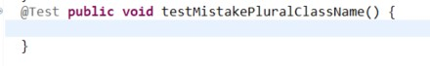
Empty test structure
Name your test according to the mistake you will test in its body
Starts with “@Test”

Slide 11
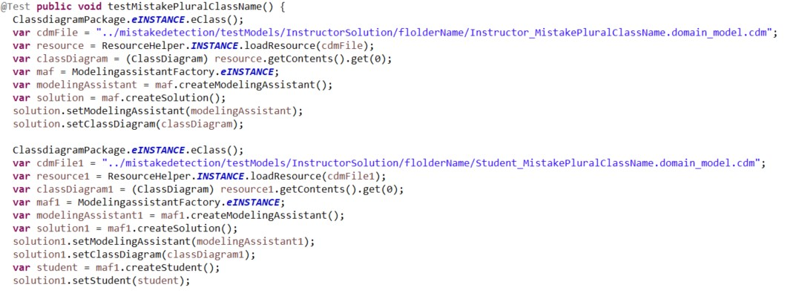
Sample test structure (1/3)
Code to load cdm file
Code may change in future
Name of instructor solution class diagram file
Relative path of cdm file
Similarly, load student solution class diagram file
In coming slides you will learn to create a cdm file!!!

Slide 12
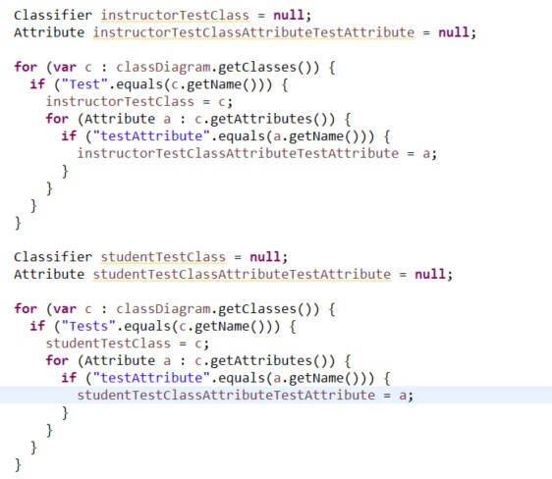
Sample test structure (2/3)
Define the classifier and Attributes you created in cdm file
Initialize the defined variables
Similarly, repeat the same for student solution

Slide 13
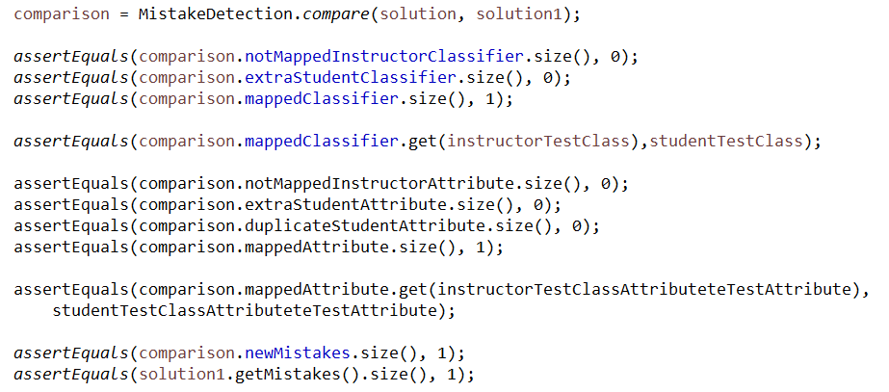
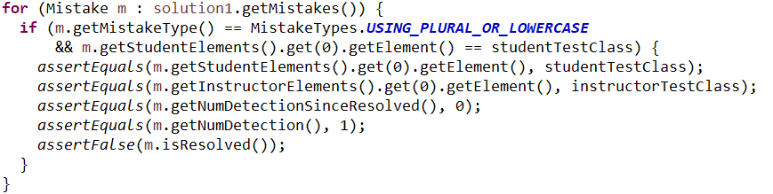
Sample test structure (3/3)
Call the compare function of Mistake Detection System, it will return an object of comparison class which contains the hashmaps and lists
These check the correctness of mapping in terms of classifier (class).
This check if correct elements are mapped
Similar in case of attributes
Asserting size of detected mistake and Mistakes introduced in class diagram
Check the correctness of mistake type and its solution element

Slide 14
Explanation of Hash maps and lists used in previous slides
Contains Classes existing in Instructor solution and not in student solution
Contains Classes existing in student solution and not in instructor solution
Contains Classes existing in both Instructor student solution
Similar case with attribute hash maps
Number of mistakes returned by MDS
Number of mistakes associated with a student solution

Slide 15
Writing the test
In the next few slides will learn to write a sample test
You will also learn to create a cdm file using TouchCORE

Slide 16
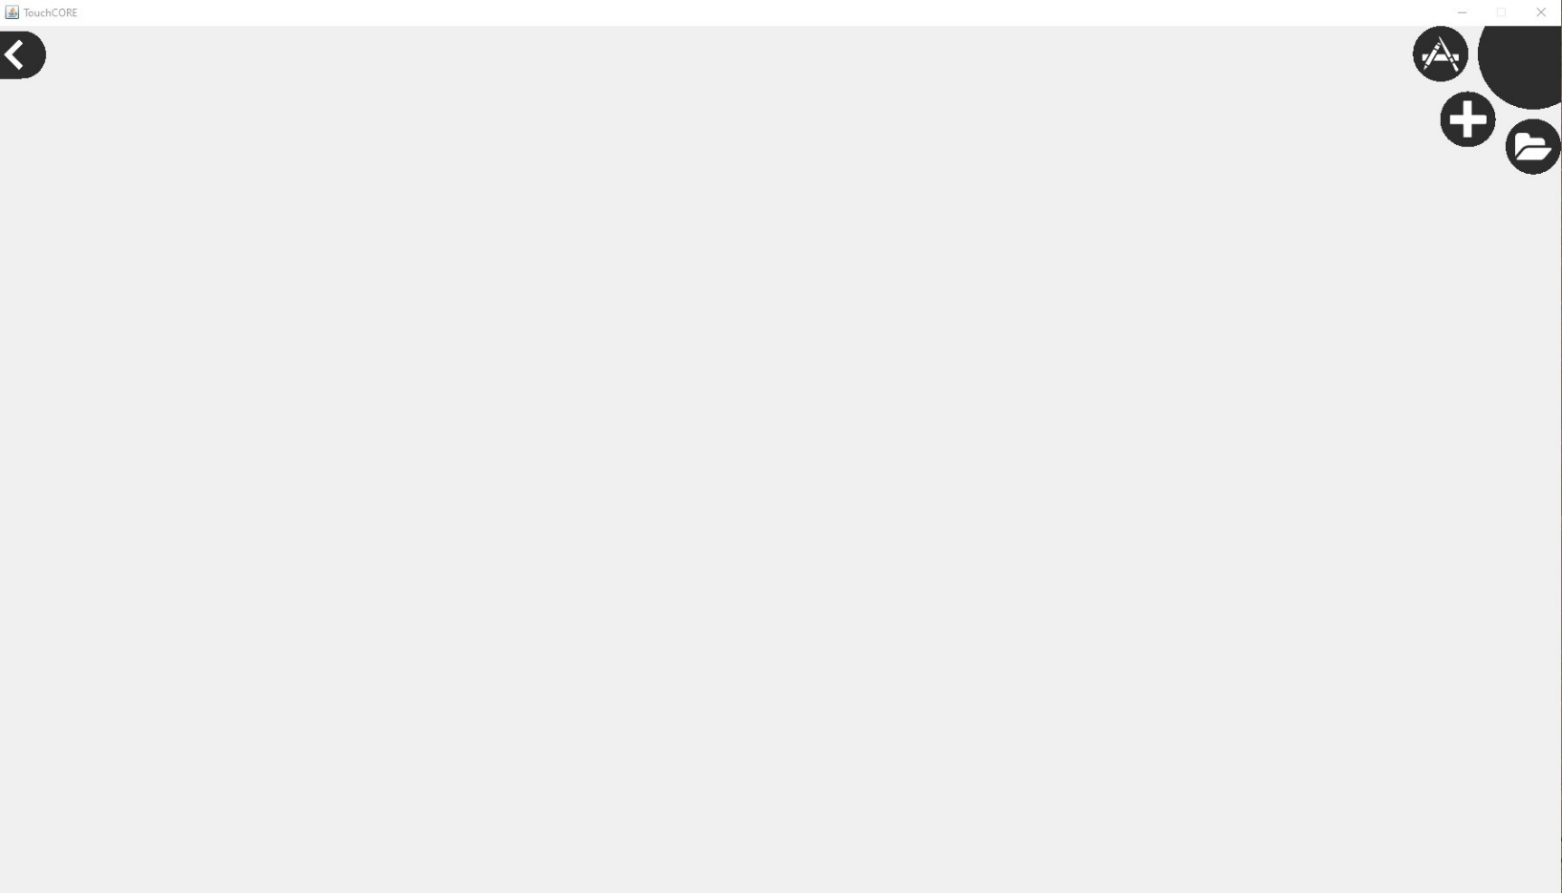
Step 1: Create a cdm using TouchCORE.
This is the home screen of TouchCORE
Click “+” to create new TouchCORE file (in this case .cdm)
Click here to open a existing TouchCORE file

Slide 17
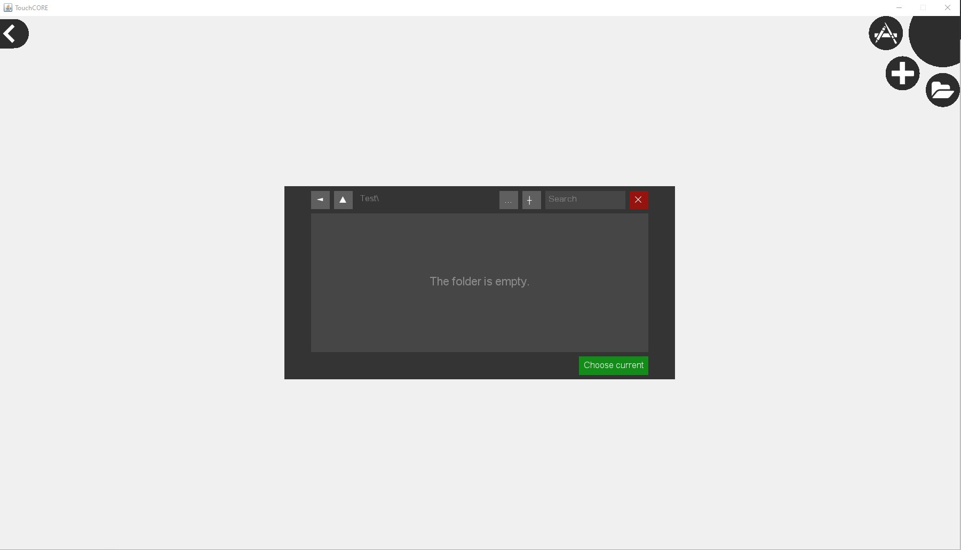
Step 1: Create a cdm using TouchCORE.
Browse to the location where you want to store the file.
Press “+” to create new folder
Click “Choose Current” to continue at that location

Slide 18
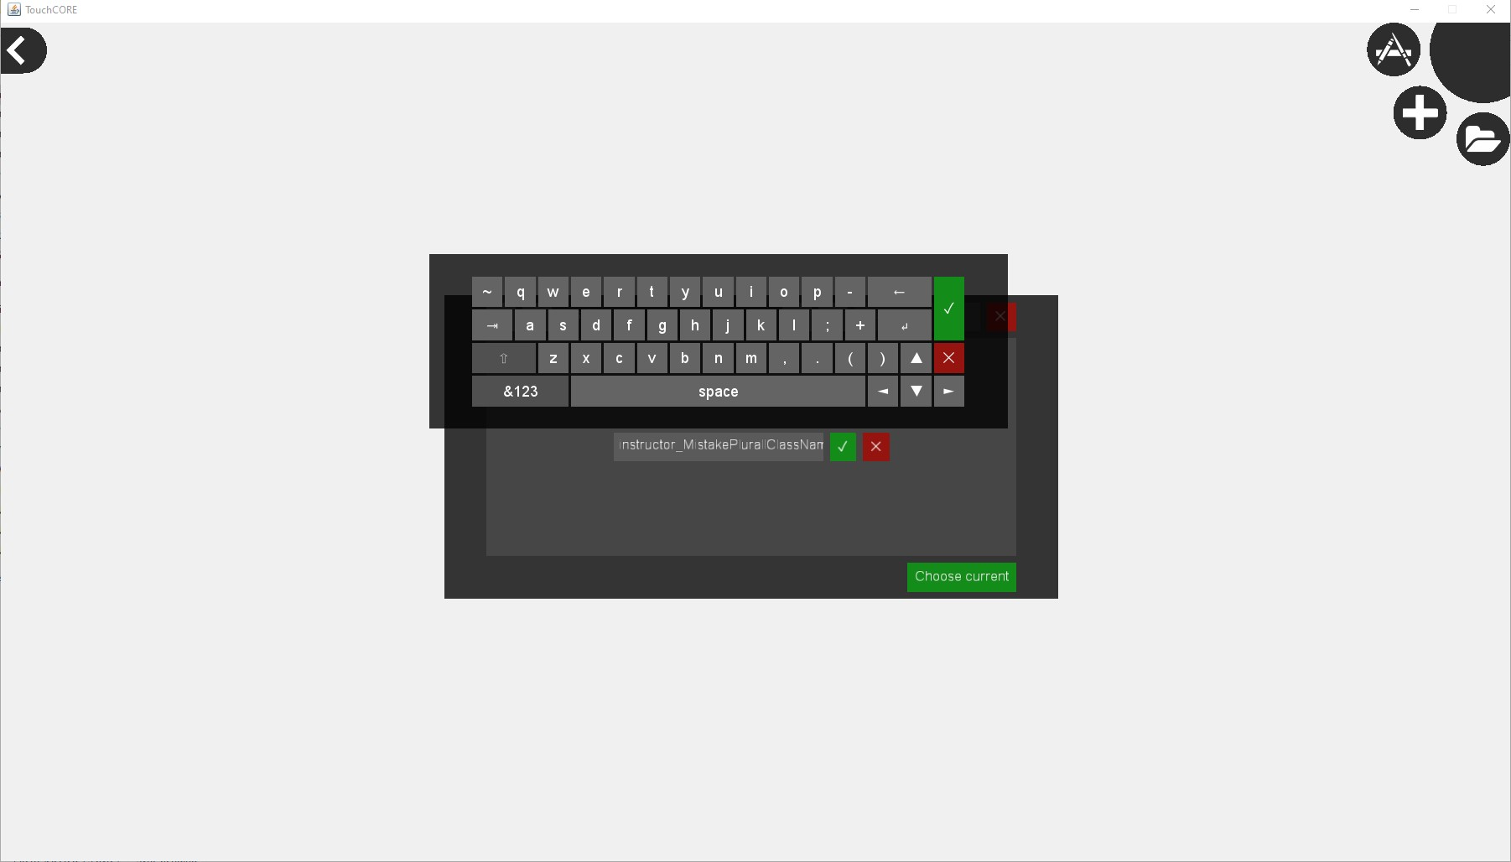
Step 1: Create a cdm using TouchCORE.
Enter the name of cdm file
!! Name the class according to its projected use. In this example “instructor_MistakePluralClassName” is used as a name, this tells us that, this is an instructor solution and will be used to test Plural class name mistake

Slide 19
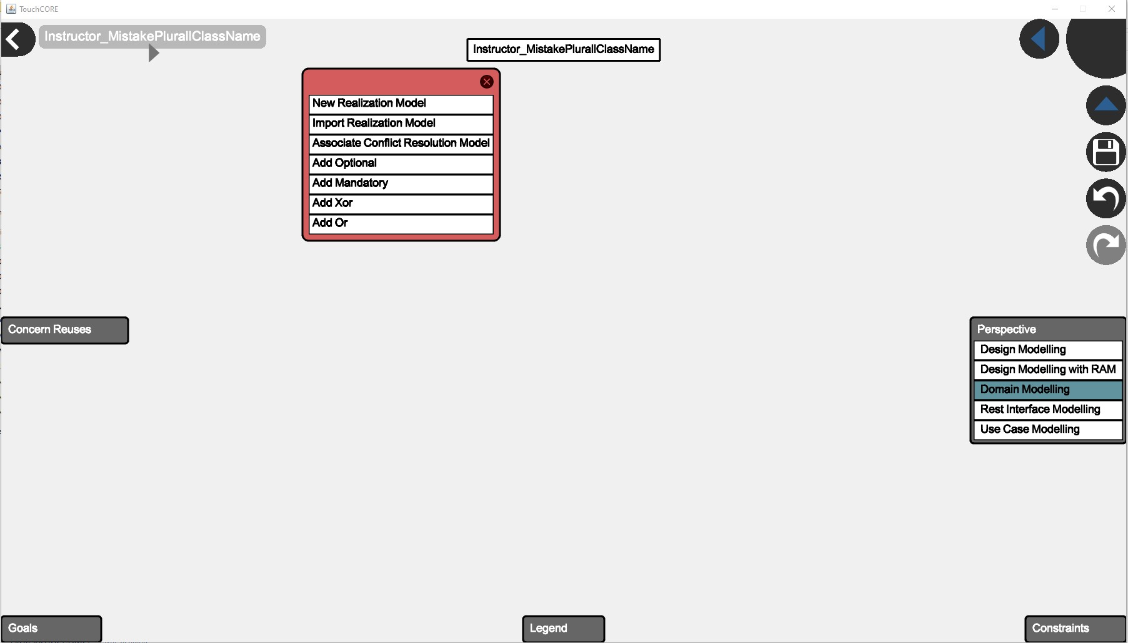
Step 1: Create a cdm using TouchCORE.
2. Hold left mouse button and select “New Realization Model”
1 .Select “Domain Modellng”

Slide 20
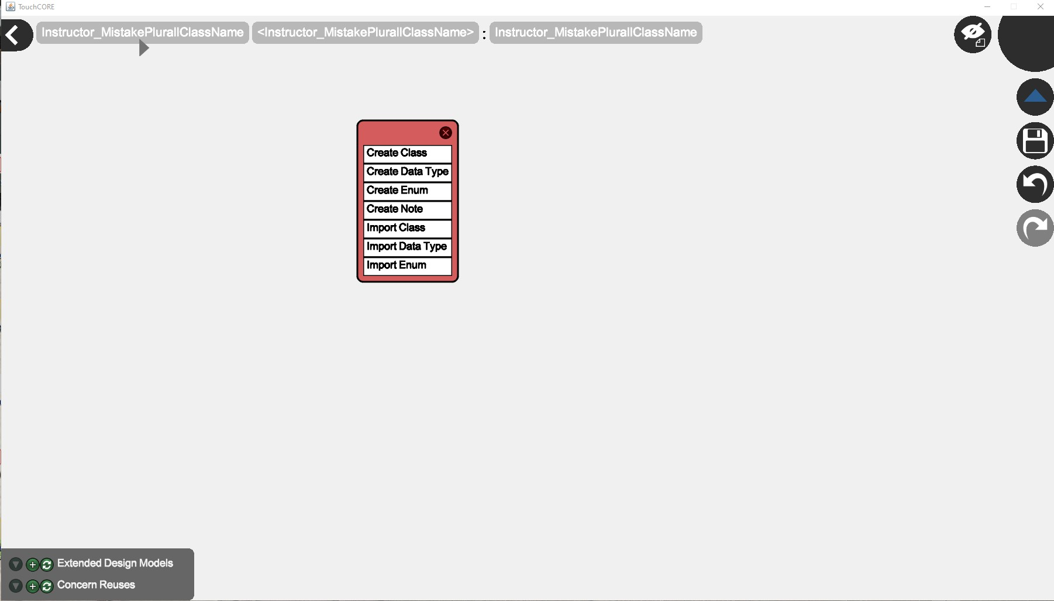
Step 1: Create a cdm using TouchCORE.
1. Hold left mouse button and select “Create Class”

Slide 21
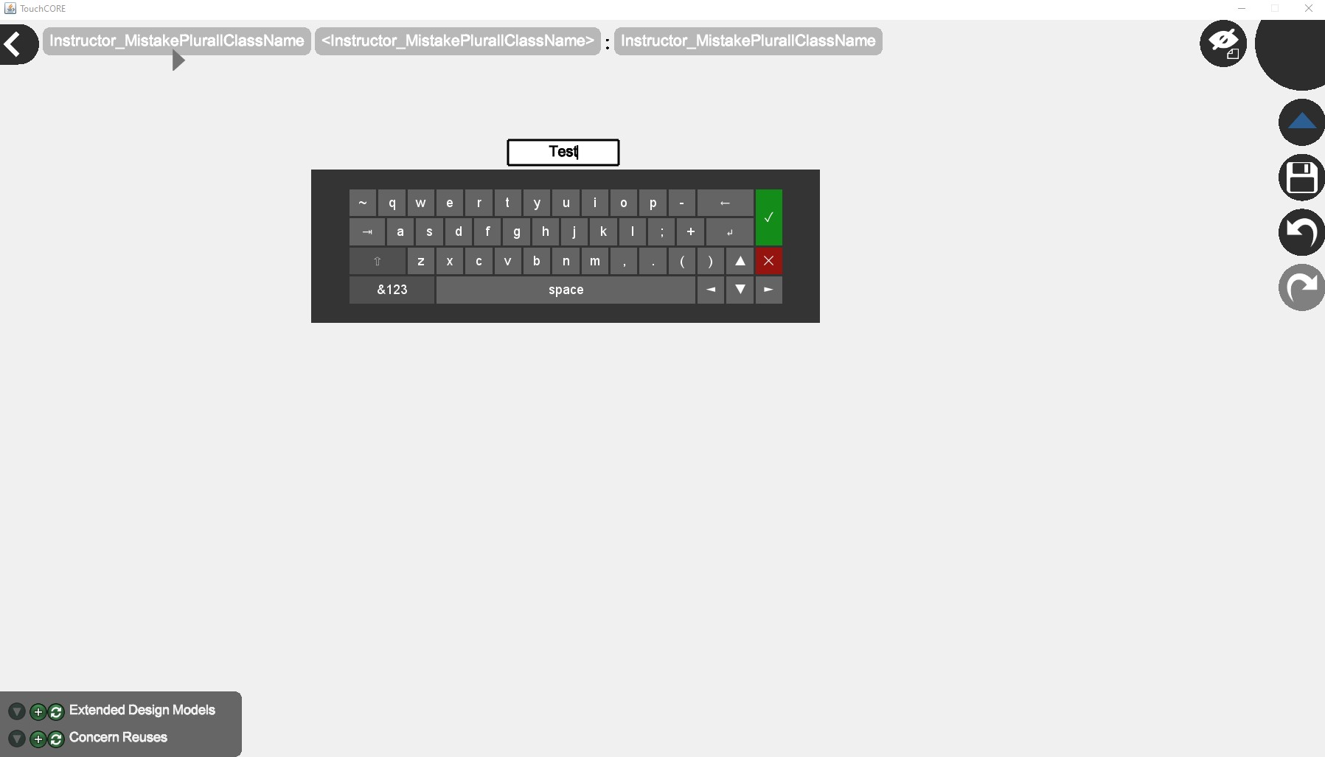
Step 1: Create a cdm using TouchCORE.
1. Name the Class
2. Save

Slide 22
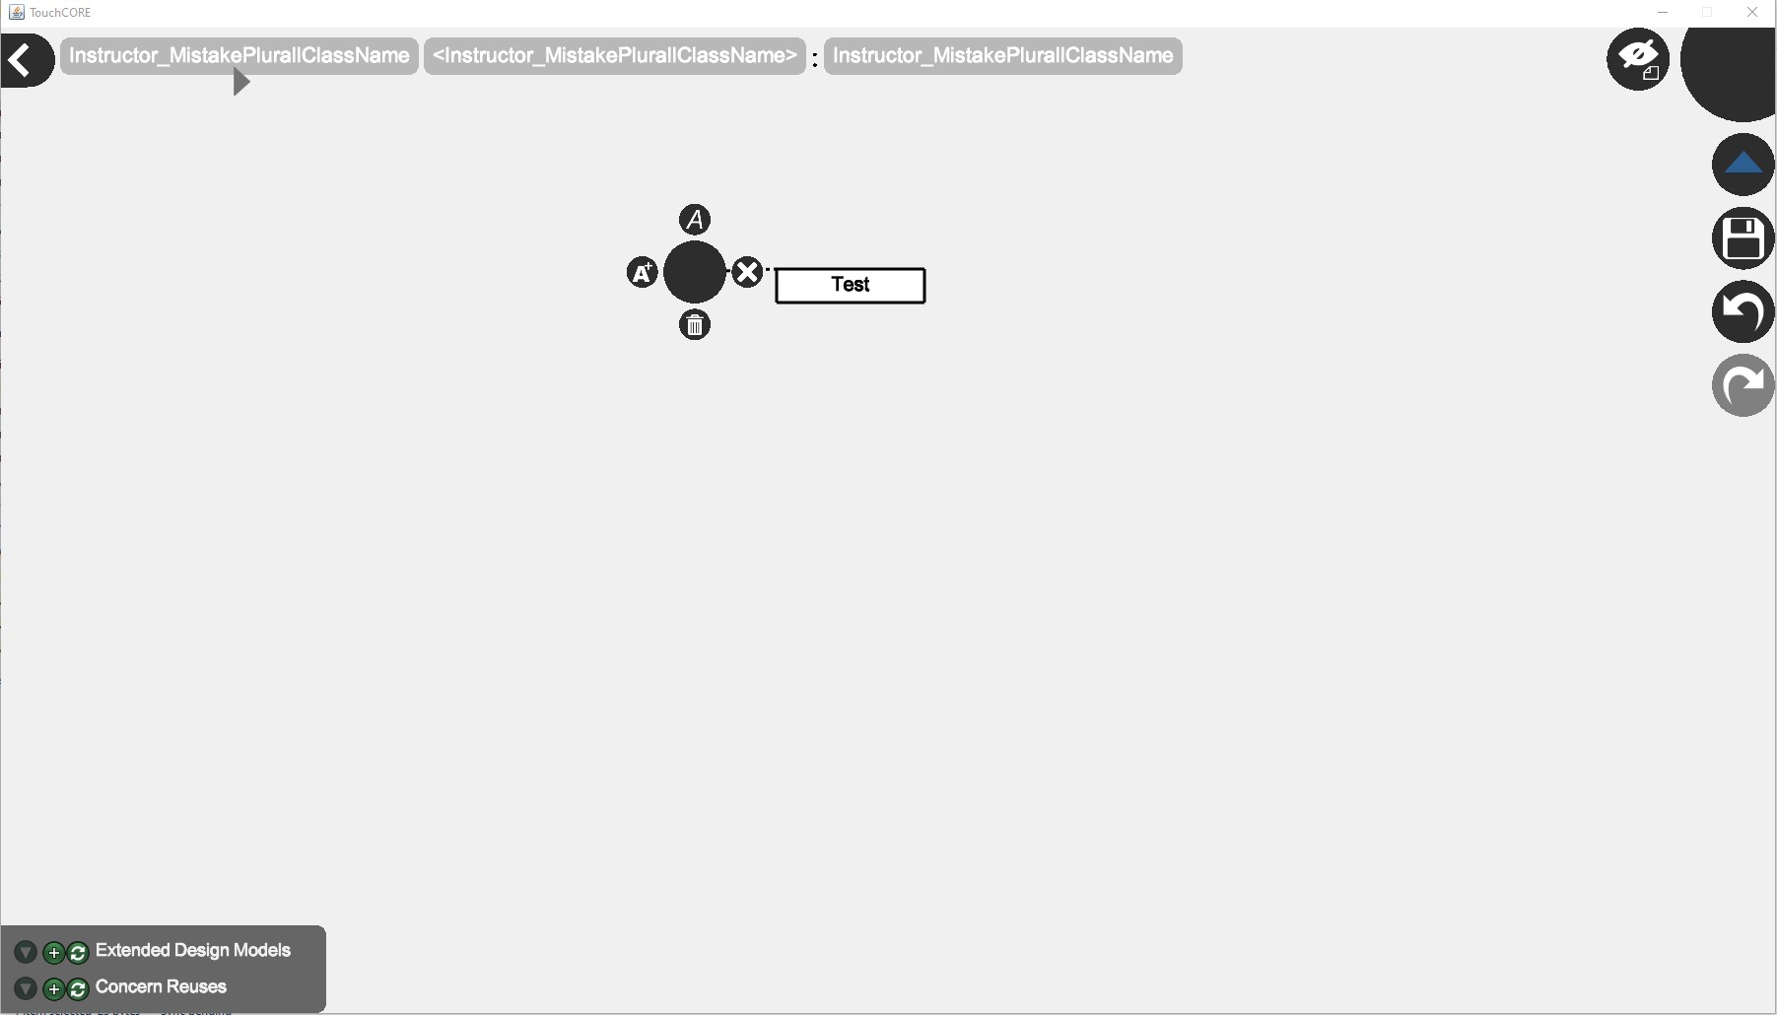
Step 1: Create a cdm using TouchCORE.
1. To Add attribute long press (hold left mouse button) the class
2. Press “A*”

Slide 23
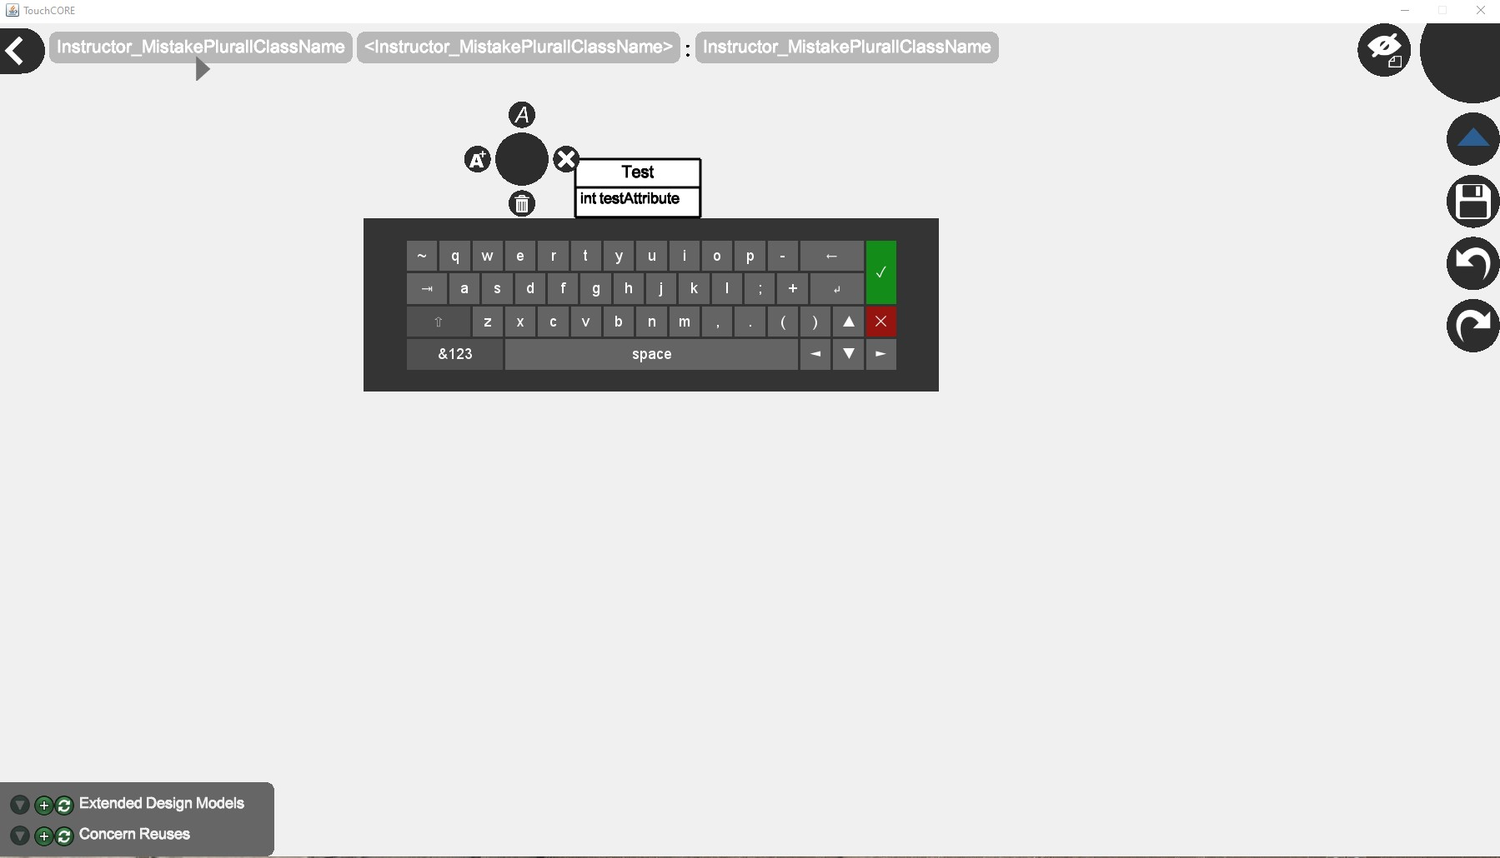
Step 1: Create a cdm using TouchCORE.
1. Enter the data type and name of the attribute
2. Save

Slide 24
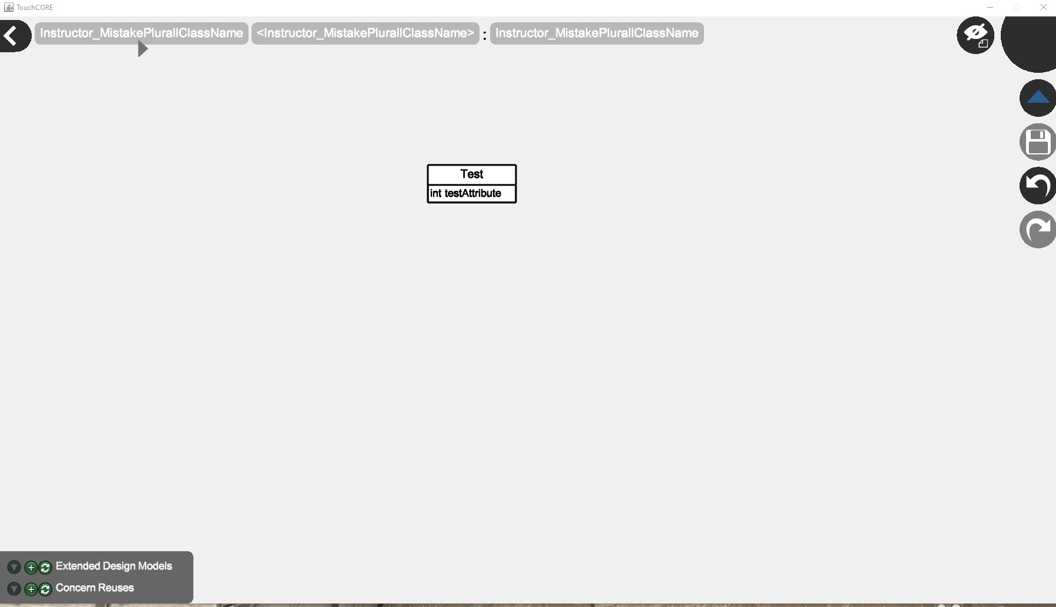
Step 1: Create a cdm using TouchCORE.
Important !!
1. Take a screenshot of the created class diagram. This will help to look at the class diagram in future
Bravo !! your class diagram is now ready .
2. Save
Note: You can create more classes, in similar way

Slide 25
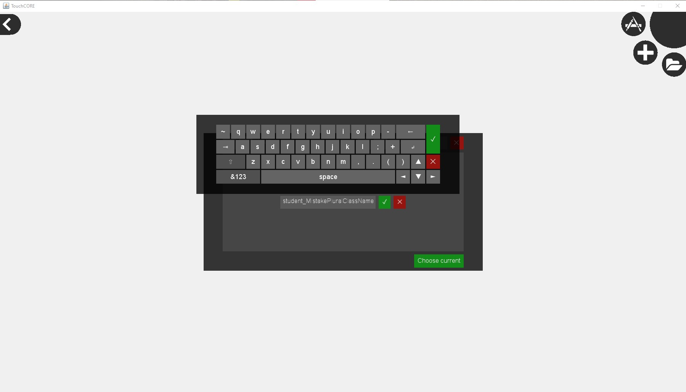
Step 1: Create a cdm using TouchCORE.
Now browse to a new location and create a cdm for student solution
!! Name the class according to its projected use. In this example “student_MistakePluralClassName” is used as a name, this tells us that, this is an student solution and will be used to test Plural class name mistake

Slide 26
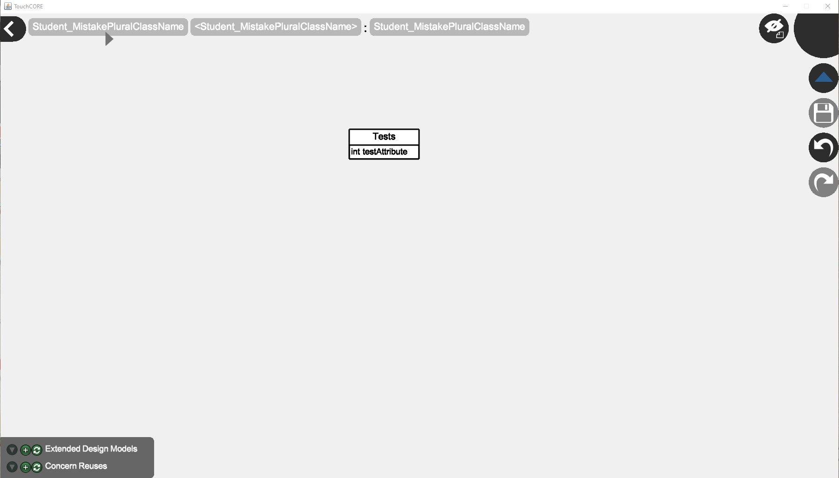
Step 1: Create a cdm using TouchCORE.
Using the previously learned steps we have create a student solution
Important !!
Take a screenshot of the created class diagram. This will help to look at the class diagram in future
Important!!
Note the name of class is “Tests” which is plural, this is done to test the Mistake Detection System

Slide 27
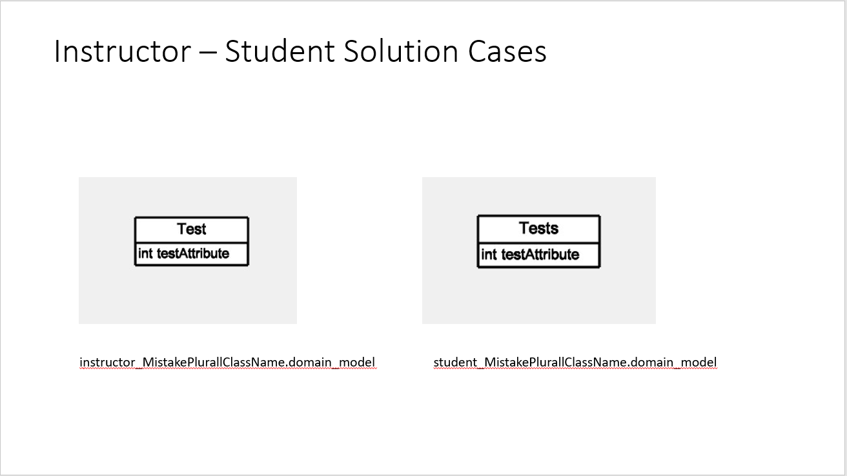
Step 1: Create a cdm using TouchCORE.
Important !!
Create a PowerPoint presentation and add the screenshots, for future reference
Sample Slide

Slide 28
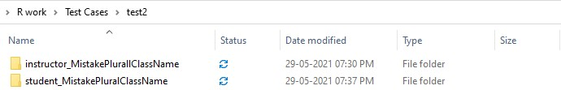
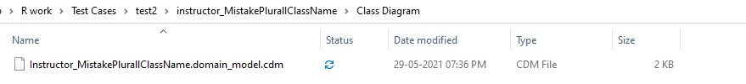
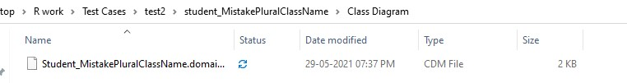
Step 1: Create a cdm using TouchCORE.
This is how the folders will look at the saved location
The files we require for testing
( .cdm )

Slide 29
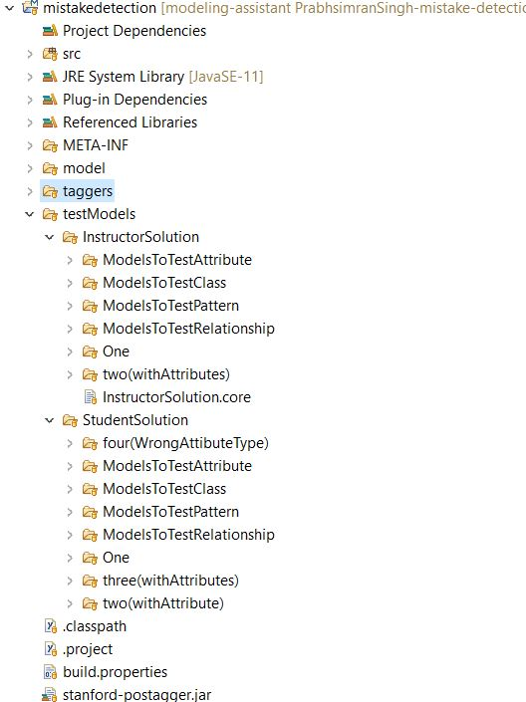
Step 2: Copying File to project
Copy the .cdm to the folder according to the mistake to be tested
In this example the instructor solution file will go to:
testModels->InstructorSolution->ModelsToTestClass
And the student solution file will go to:
testModels->StudentSolution->ModelsToTestClass

Slide 30
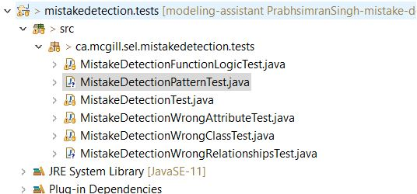
Step 3: Writing Test
Go to the Mistake appropriate java File to write a test
In this example, you will write test in “MistakeDetectionWrongClassTest”

Slide 31
Step 3: Writing a test
Name your test according to the mistake you will test in its body
Starts with “@Test”

Slide 32
Step 3: Writing a test
1. Load cdm file
Name of instructor solution class diagram file
Relative path of cdm file
Similarly, load student solution class diagram file

Slide 33
Step 3: Writing a test
2. Define the classifier and Attributes you created in cdm file
3. Initialize the defined variables
4. Similarly, repeat the same for student solution

Slide 34
Step 3: Writing a test
5. Call the compare function of Mistake Detection System, it will return an object of comparison class which contains the hashmaps and lists
5. Write assertions to check the mapping (Test = Tests).
This check if correct elements are mapped
Similar in case of attributes
6. Assert the size of detected mistake and Mistakes introduced in class diagram
7. Check the correctness of mistake type and its solution element

Slide 35
Thank you and have fun using Mistake Detection System

